Slide 1
Sales Insights and Revenue Trends
Presented by : Arundeep Gangoni

Slide 2
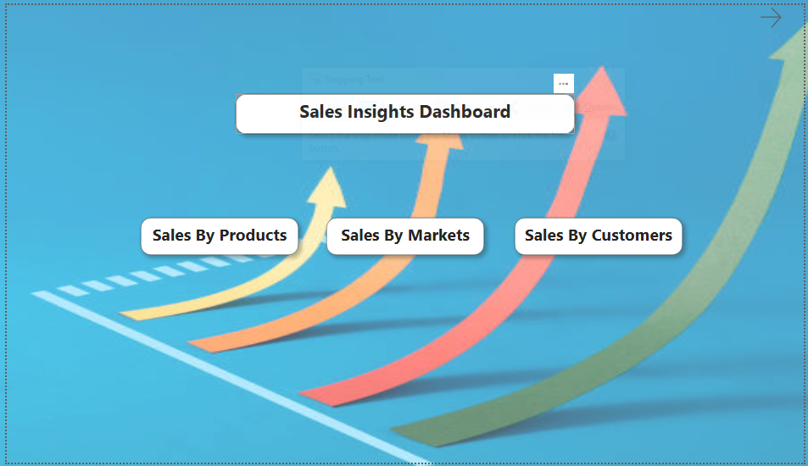

Slide 3
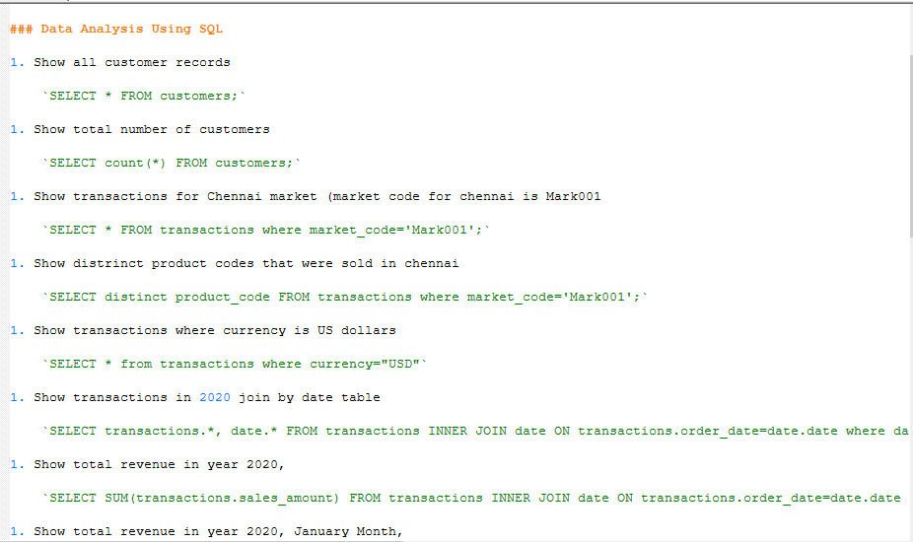

Slide 4
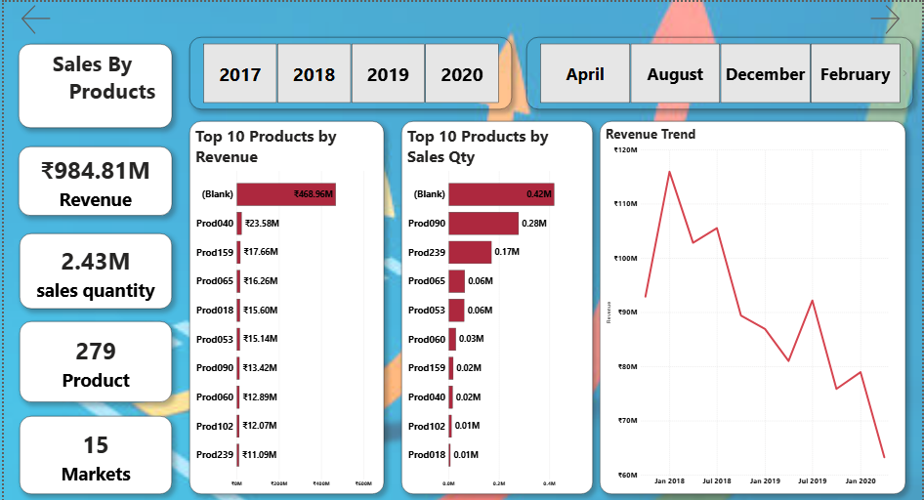

Slide 5
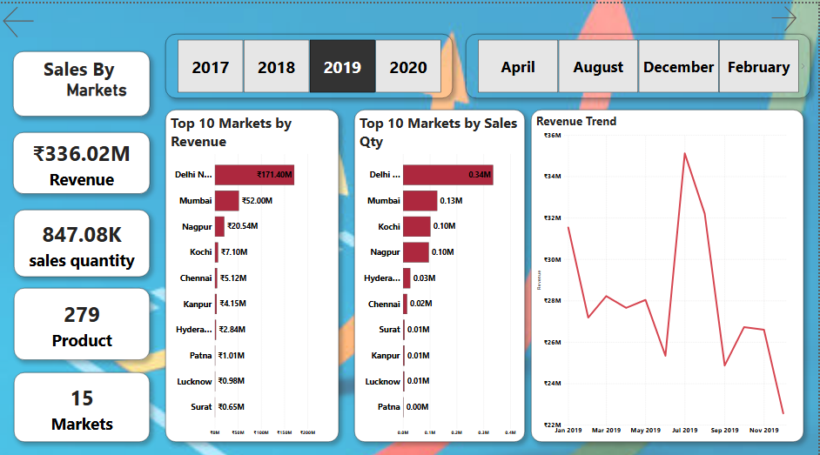

Slide 6
